Slide 1
Palindrome check
2023/03/09

Slide 2
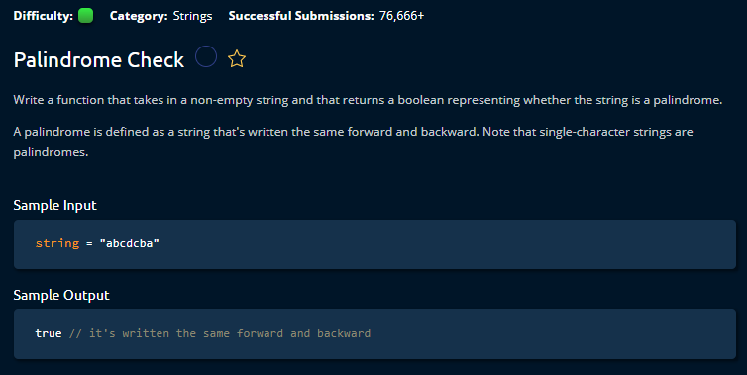

Slide 3
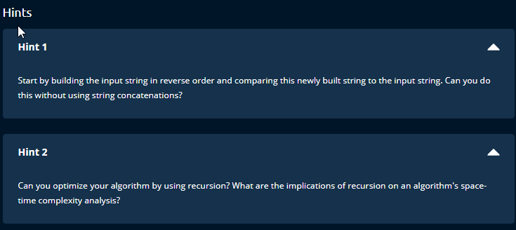

Slide 4
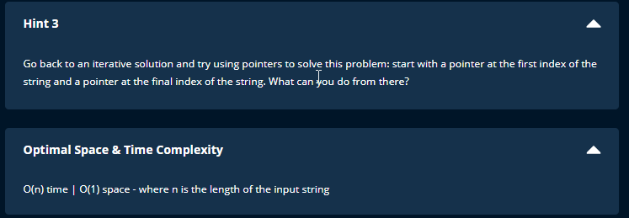

Slide 5
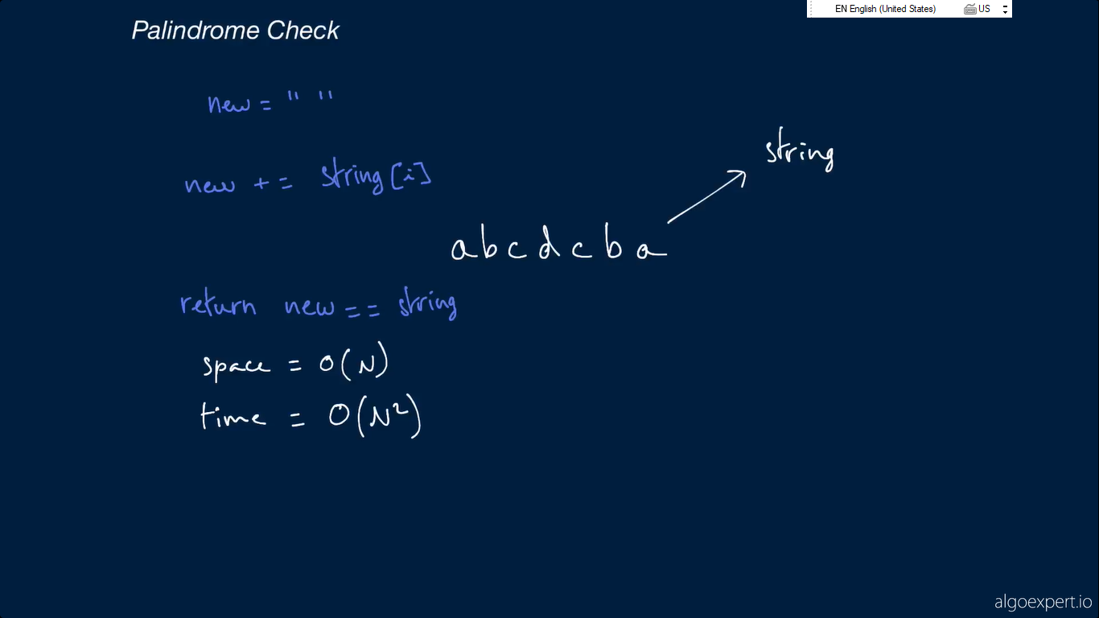
Creating new array
String concatenation

Slide 6
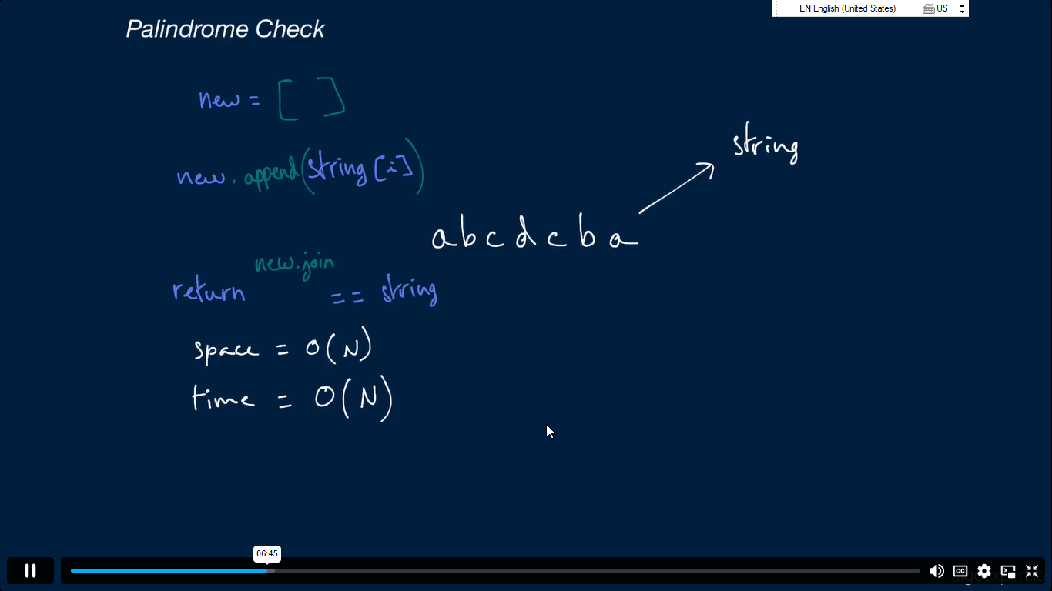
Append is better than concatenation in term of time complexity

Slide 7
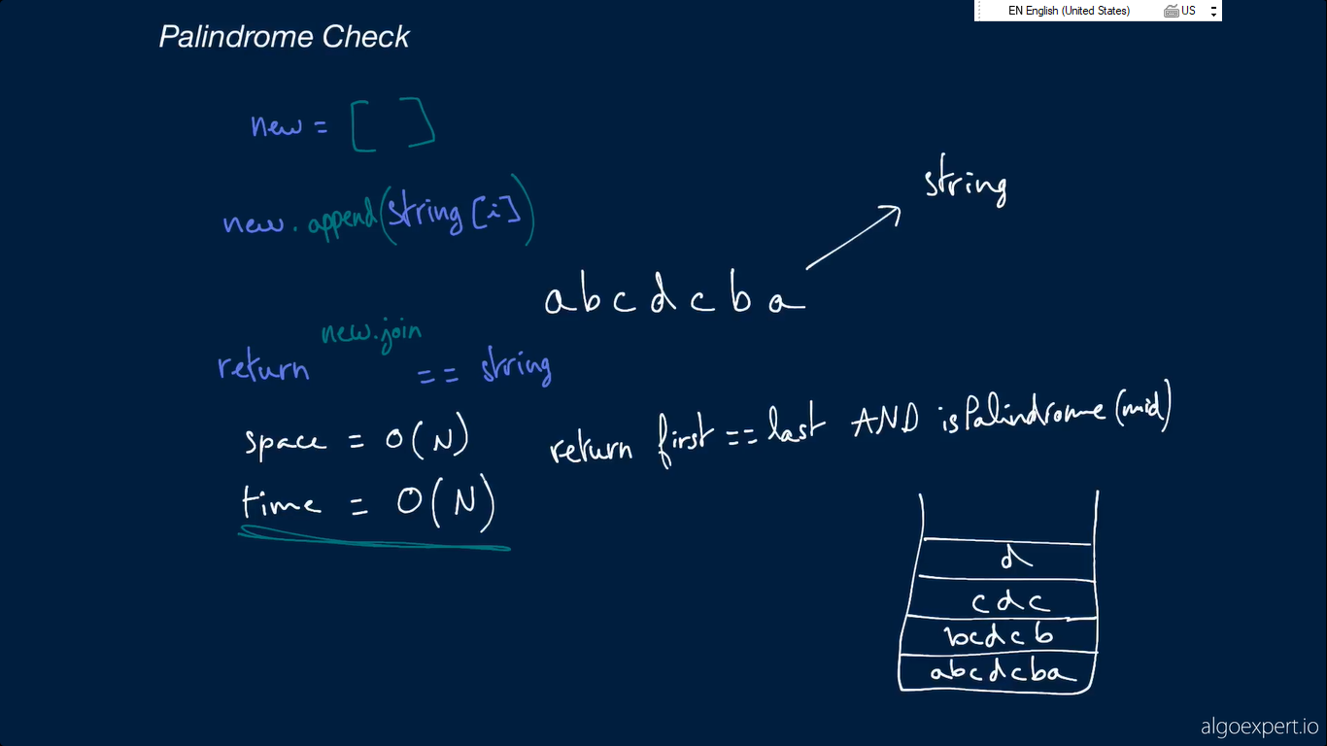
Recursion
Call stack use additional memory thus O(n)

Slide 8


Slide 9


Slide 10


Slide 11
